Slide 1

CIS IBM Cloud Foundations Benchmark
ThS. Nguyễn Duy
19521722 – Vũ Trung Kiên
19521876 – Võ Hoài Nam
19522398 – Trần Nguyễn Minh Triết
19522053 – Huỳnh Lê Hữu Phước
19521190 – Bùi Đức Anh

Slide 2
TABLE OF CONTENTS
1. IAM
2. Storage
3. Maintenance, Monitoring and Analysis of Audit Logs
4. IBM Cloud Databases Family
5. Cloudant
6. Networking
7. Containers
8. Key Management
9. Security and Compliance
10. IBM Cloud Certificate Manager
1

Slide 3


1. IAM
- Securely authenticate users and control access to resources consistently.
- Use for access control, and group resource within your account to give users access quickly to more than one resource at a time.
- Assign users and service IDs access to resources within your account.
- Group users and service IDs into an access group to easily give all members of the group the same level of access.
2

Slide 4

2. Storage
IBM® Cloud Object Storage stores encrypted and dispersed data across multiple geographic locations, and accessed over popular protocols like HTTPS using a modern RESTful API.
3

Slide 5

3. Maintenance, Monitoring and Analysis of Audit Logs
- Collect audit events to monitor activity
- Archive events for long-term storage so that recover quickly
- Collect and process events to identify anomalies or abnormal events
- Alerts are defined to notify promptly of problems, anomalies, and abnormal situations
4

Slide 6
3. Maintenance, Monitoring and Analysis of Audit Logs
- Monitor the account owner's access to the IBM Cloud account is done from authorized locations that are restricted by IP addresses.
- Ensure Activity Tracker data is encrypted at rest.
- Check whether Activity Tracker trails are integrated with LogDNA Logs
5

Slide 7
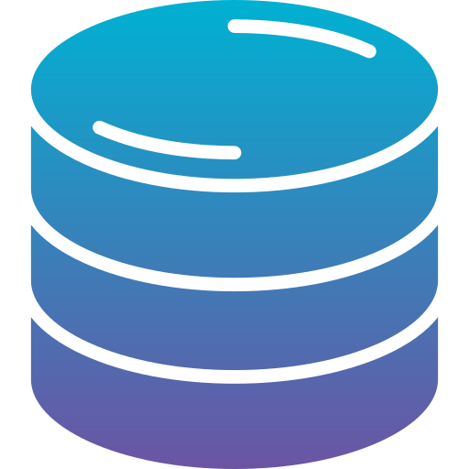
4. IBM Cloud Databases Family 5. Cloudant
- Manage customer root keys that are used to protect customer data stored in data and storage services in IBM Cloud with BYOK.
- Customer must restore a backup with a new encryption key or create a net new database instance with Bring Your Own Key enabled.
- Only encrypted communication to the database is accepted.
- Database is encrypted at-rest by default and no user action is needed.
- Customers that are required to do should IP Whitelist the database before enabling "Public" endpoints.
6

Slide 8

6. Networking
- In this section, IBM Cloud offers a range of security settings for services like TLS, WAF, VPC.
- These modifications focus on the security of IBM Cloud Internet Service, such as:
+ Increase TLS version to TLS 1.2 or higher
+ WebApp Firewall
+ DDOS Protection
+ Access Control List limit access to services on port 22 and 3389
- Its benefit is help increase the overall security for apps, webapps deployed on IBM Cloud like preventing DDOS, avoiding common attacks on WebApps, encrypting data from client to server, restrict network traffic policy
7

Slide 9
7. Containers
- Deploy highly available containerized apps in Kubernetes clusters and use the powerful tools of IBM Cloud™ Kubernetes Service to automate, isolate, secure, manage, and monitor your workloads across zones or regions.
- This section mostly about using Key Management Service (KMS) for encrypting Kubernets secrets and ways to increase IBM Cloud™ Kubernetes service security
- The options are:
+ BYOK allows users to create, use, rotate and delete their own key
+ KYOK allows users to take the ownership of the cloud HSM to fully manage your encryption keys
+ Ensure TLS 1.2 or higher for all inbound traffic to IBM Cloud Kubernetes Service Ingress
+ Ensure Ingress accesses are from private endpoint
+ Ensure monitoring and logging services are enabled
- Besides, this section also mentions about container registry.
- IBM Cloud™ Container Registry to store and access private container images in a highly available and scalable architecture.
- IBM Cloud Container Registry provides a multi-tenant, highly available, scalable, and encrypted private image registry
- Option for security is block deployment of vulnerable images to Kubernet Clusters
8

Slide 10

8. Key Management
- This section mention how one can use Key Protect for IBM Cloud in order to protect other important keys from being leaked
- Root keys are symmetric key-wrapping keys that you fully manage in Key Protect, can be used to protect other keys
- There are two options:
+ Ensure IBM Key Protect has automated rotation for customer managed keys enabled
+ Ensure the IBM Key Protect service has high availability
9

Slide 11

9. Security and Compliance
Through pre-integrated findings, you can monitor:
+ Certificates that you manage with IBM Cloud Certificate Manager
+ Vulnerabilities in container images that are stored in IBM Cloud Container Registry
10

Slide 12

10. IBM Cloud Certificate Manager
- This section mention about Certificate Manager for IBM Cloud and how it can help increase the security of IBM Cloud through Certificate management
- The option for it is:
+ Ensure certificates generated through IBM Cloud Certificate Manager are automatically renewed before expiration
- The option provided helps ensure Application security by renewing the outdated certificate to make sure no vulnerability exposed.
11

Slide 13

THANKS!
Do you have any questions?
19521722 - 19521876
19522398 – 19522053 – 19521190

